Slide 1
Resampling and Interpolation
Up sampling
Down sampling

Slide 2
Resampling and Interpolation
You may have observations at the wrong frequency. Maybe they are too granular or not granular enough.
The Pandas library in Python provides the capability to change the frequency of your time series data….. both increase and decrease the sampling frequency of time series data.
Time series resampling : two types of resampling
upsample time series data to a higher frequency and interpolate the new observations…. such as from minutes to seconds
downsample time series data to a lower frequency and summarize the higher frequency observations…..such as from days to months
In both cases, data must be invented. In the case of upsampling, care may be needed in determining how the new-grained observations are calculated using interpolation. In the case of downsampling, care may be needed in selecting the summary statistics used to calculate the new aggregated values.

Slide 3
Resampling
Resampling involves changing the frequency of your time series observations. Two types of resampling are:
Upsampling: Where you increase the frequency of the samples,.
Downsampling: Where you decrease the frequency of the samples,.

Slide 4
Shampoo Sales Dataset
Shampoo Sales dataset describes the monthly number of sales of shampoo over a 3 year period. shampoo-sales.csv.
The Shampoo Sales dataset only species year number and months (e.g. 1-01).
A custom function is used to parse the dates and baseline the year number on an arbitrary year (1900) so that the date-times can be be interpreted correctly in the Pandas Series.

Slide 5
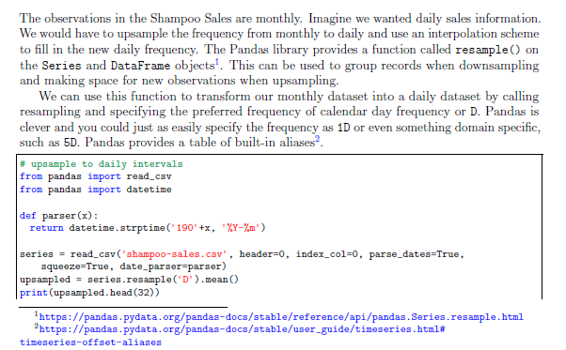
Upsampling Data

Slide 6
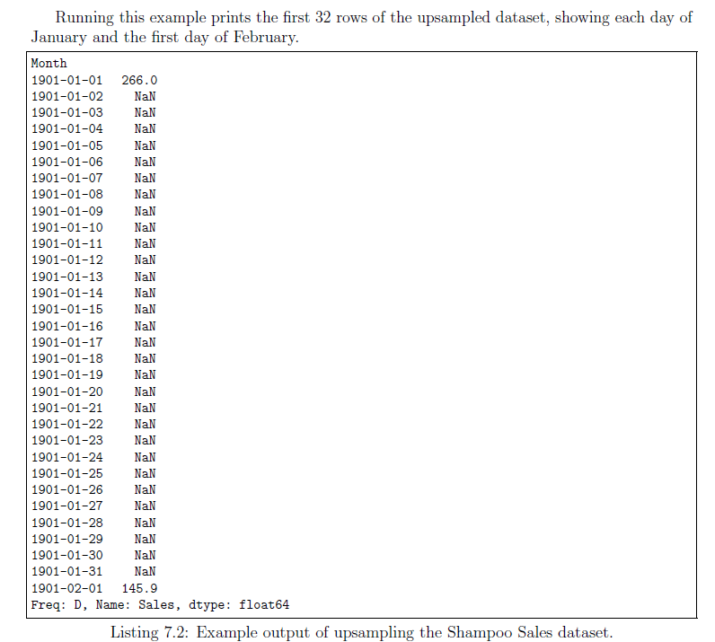
Upsampling Data

Slide 7
Upsampling Data
The Series Pandas object provides an interpolate() function to interpolate missing values, and there is a nice selection of simple and more complex interpolation functions.
A good starting point is to use a linear interpolation. This draws a straight line between available data, in this case on the rest of the month, and fills in values at the chosen frequency from this line.

Slide 8
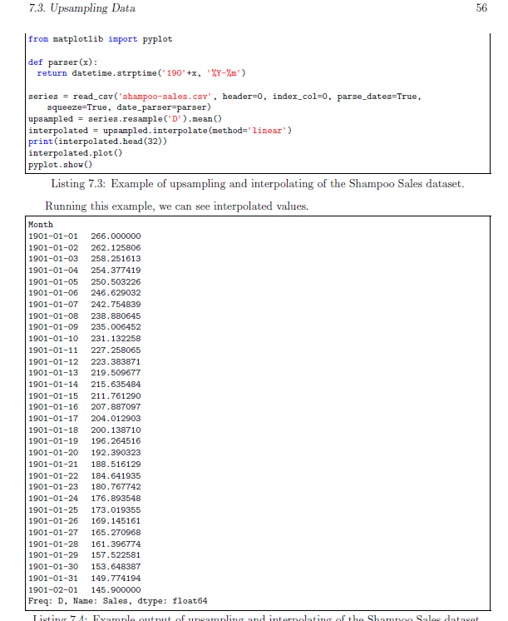
Upsampling Data

Slide 9
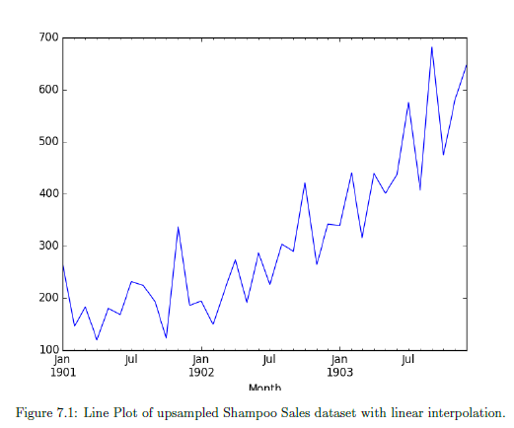
Upsampling Data

Slide 10
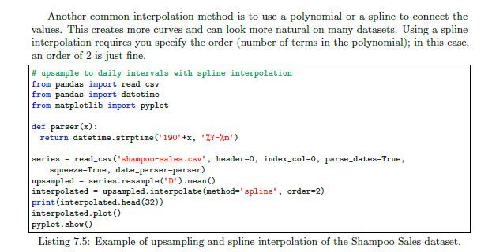
Upsampling Data
Interpolation: Polynomial/ Spline

Slide 11
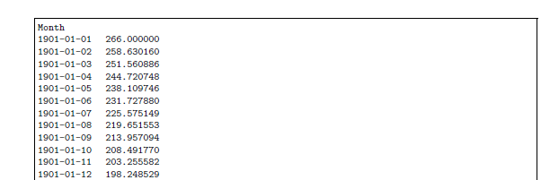
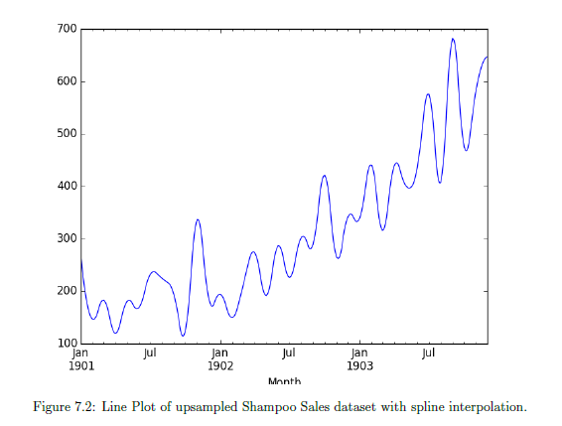
Upsampling Data
Interpolation: Polynomial/ Spline

Slide 12
Downsampling Data
The sales data is monthly, but perhaps we would prefer the data to be quarterly.
The year can be divided into 4 business quarters, 3 months a piece. Instead of creating new rows between existing observations, the resample() function in Pandas will group all observations by the new frequency.
Pandas does have a quarter-aware alias of Q for this purpose….now decide how to create a new quarterly value from each group of 3 records.
A good starting point is to calculate the average monthly sales numbers for the quarter. For this, use the mean() function.

Slide 13

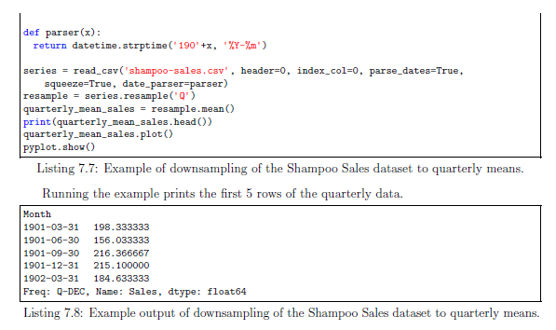
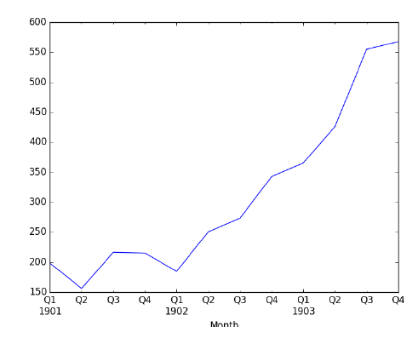
Down Sampling Data

Slide 14
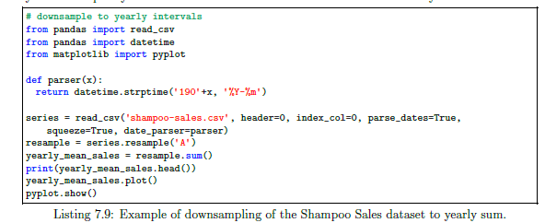
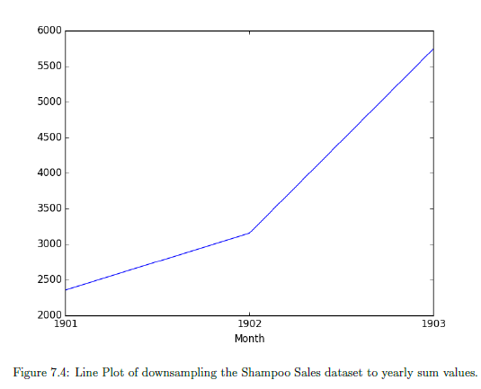
Down Sampling : Yearly frequency

Slide 15
Practice Lab

